Slide 1
FTA Procurement Training

Slide 2
Session Coverage
Procurement Resources
New Developments in Procurement Compliance
Micro Purchases
Small Purchases (AKA Simplified Acquisitions)
Formal Purchases
Non-Competitive Procurements
Joint and “Piggyback” Procurements
Rolling Stock Procurements
Rolling Stock Disposition
Procurement Policy
Common Procurement Findings
Notes:
6

Slide 3
Procurement Resources
FTA Circular 4220.1F (link)
Last updated March 2013; due for revision
Best Practices Procurement Manual (link)
Last updated October 2016; due for revision
FY2023 FTA Contractors Manual (link)
Updated yearly (except for 2021); previously known as the Comprehensive Review Guide
2 CFR 200 “Super Circular” (link)
ProcurementPRO (link)
Notes:
6

Slide 4
New Developments in Procurement Compliance

Slide 5
New Developments: Increases to Procurement Thresholds
The Office of Management and Budget (OMB) raised the Federal micro-purchase limit from $3,500 to $10,000 and the Federal simplified acquisition threshold from $150,000 to $250,000, effective June 20, 2018
FTA has yet to update its procurement guidance to reflect OMB’s increases
Circular 4220 and the BPPM are due for updates
Notes:
6

Slide 6
New Developments: Increases to Procurement Thresholds
It is important to note that FTA recipients/subrecipients are free (and often required) to set thresholds lower than the Federal thresholds set by OMB
For most FTA subrecipients in North Dakota, micro purchases are less than $10,000, small purchases range from $10,000 to $100,000, and formal purchases are above $100,000
For most FTA subrecipients in South Dakota, micro purchases are less than $4,000, small purchases range from $4,000 to $50,000, and formal purchases are above $50,000
Notes:
6

Slide 7
Micro Purchases

Slide 8
Micro Purchases: Overview
Micro Purchases (less than $10,000 for ND; less than $4,000 for SD)
FTA’s only documentation requirement for micro purchases is a determination that the price is fair and reasonable as well as a basis for this determination
To the extent practicable, recipients must distribute micro purchases equitably among qualified suppliers
Recipients may not divide or reduce the size of procurements to avoid the additional procurement requirements applicable to larger acquisitions (this is also applicable to small purchases)
Notes:
6

Slide 9
Micro Purchases: Tools
$4,000 for SD subrecipients
Notes:
6

Slide 10
Small Purchases (AKA Simplified Acquisitions)

Slide 11
Small Purchases: Overview
Small Purchases ($10,000 to $100,000 for ND; $4,000 to $50,000 for SD)
Recipients must obtain oral or written price quotations from an adequate number of qualified sources
The award must be made to the lowest responsive and responsible vendor
A written procurement history must be maintained for small purchases, commensurate with the size and complexity of the procurement
Relevant FTA-required contract clauses must be included
Develop an Independent Cost Estimate (ICE) prior to the receipt of bids or proposals (best practice)
Conduct a Cost or Price Analysis after the receipt of bids or proposals but prior to the award of a contract (best practice)
Notes:
6

Slide 12
Responsive
Responsive means the bidder conforms in all material aspects to the requirements of the solicitation at the scheduled time of submission
“Material” means affecting the substance of the bid (e.g., price, quantity, quality, timeline)
Responsiveness determination to be conducted upon receipt of bids/proposals
Notes:
6

Slide 13
Responsible
Responsible means that the bidder possesses the ability, willingness, and integrity to perform successfully under the terms and conditions of the contract
Must determine that bidders/proposers were not excluded or disqualified before entering into a contract. This can be accomplished by:
checking SAM Exclusions (at SAM.gov), or
adding a clause or condition to the covered transaction, or
collecting a certification
Notes:
6

Slide 14
Responsible
A written responsibility determination must be made for each successful bidder prior to award with consideration was given to matters such as:
contractor integrity
compliance with public policy
record of past performance, and
financial and technical resources
Notes:
6

Slide 15
FTA-required Third Party Contract Clauses
Recipients must include specific required clauses in FTA-funded contracts
Not all clauses apply to every contract. The applicability of clauses depends on the size and type of the procurement as illustrated on the following slides
Notes:
6

Slide 16
FTA-required Clauses
Notes:
6

Slide 17
FTA-required Clauses
Notes:
6

Slide 18
FTA-required Clauses
The Takeaway: There is a large number of FTA-required clauses and determining their applicability can be complicated. But worry not…
Notes:
6

Slide 19
Dealing with the FTA Clauses Requirement
One solution is National RTAP’s ProcurementPRO, a free web-based procurement tool that guides recipients through FTA procurement procedures. ProcurementPRO is available at: www.nationalrtap.org/Web-Apps/ProcurementPRO
Notes:
6

Slide 20
Dealing with the FTA Clauses Requirement
The best practice is to include clauses in the solicitation as well as the resulting contract
Makes potential proposers aware prior to negotiating contract
Solicitation documents often incorporated into contract by reference
Unlikely that auditors will miss the clauses
Notes:
6

Slide 21
Independent Cost Estimate (ICE)
An ICE is a recipient’s estimate of what an item or service “should” cost
An ICE can range from a simple budgetary estimate to a complex estimate
Available data points for developing an ICE include: published price lists, historical pricing information from contracts awarded, comparable purchases by other agencies, and independent third party estimates
Notes:
6

Slide 22
Independent Cost Estimate (ICE)
The word “independent” does not imply that it must be performed by someone other than the recipient, although this may be the case for complex procurements
The ICE must be conducted prior to the receipt of bids or proposals, and is therefore “independent” from any pricing information received in response to the solicitation
Notes:
6

Slide 23
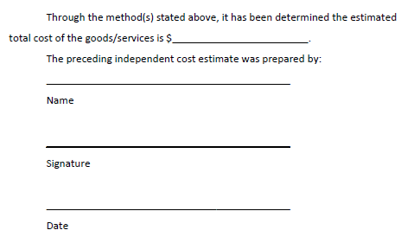
Sample ICE Form
Notes:
6

Slide 24
Cost/Price Analysis
The purpose of a cost or price analysis is to ensure the recipient does not pay unreasonably high prices to third party contractors
A cost or price analysis is performed after the receipt of bids or proposals but prior to the award of a contract
While “cost/price analysis” is often used as a combined phrase, cost analysis and price analysis are distinguishable concepts
Notes:
6

Slide 25
Price Analysis vs Cost Analysis
When contracting on a fixed price basis, a comparison of the proposed prices will normally satisfy the requirement to perform a price analysis
When price competition is inadequate, such as in a single bid or sole source procurement, the recipient must develop a cost analysis
Cost analysis is the review and evaluation of the separate cost elements and profit in an offeror’s proposal and the application of judgment to determine how well the proposed costs represent what the cost should be assuming reasonable economy and efficiency
Notes:
6

Slide 26
Formal Purchases

Slide 27
Formal Purchases: Overview
Formal Purchases (above $100,000 for ND; above $50,000 for SD)
Typically involves purchase through use of sealed bids (IFBs) or competitive proposals (RFPs)
Requires an ICE, a cost or price analysis, and applicable FTA contract clauses
Notes:
6

Slide 28
Formal Purchases: Written Procurement History
Formal purchases also require a written procurement history containing the following elements:
the rationale for the method of procurement (e.g., IFB, RFP)
selection of contract type (e.g., fixed price, cost reimbursement)
contractor selection or rejection (e.g., responsiveness and responsibility determinations, proposal evaluations)
the basis for the contract price (e.g., price or cost analysis, ICE)
Procurement history is expected to be commensurate with the size and complexity of the purchase
Notes:
6

Slide 29
Formal Purchases: RFP vs IFB
Request for Proposals (RFP): Using this method, proposals are publicly solicited from an adequate number of sources and the award is made to the responsive and responsible proposer whose offer is most advantageous to the recipient, with price and other factors considered
Invitation for Bid (IFB): Using this method, bids are publicly solicited and a firm fixed price contract is awarded to the lowest responsive and responsible bidder. Unlike RFPs, the IFB procurement method does not allow recipients to evaluate the merits of technical proposals and pay more for a higher quality product representing the best value
Notes:
6

Slide 30
Non-Competitive Procurements

Slide 31
Non-Competitive Procurements
Non-competitive procurements represent red flags for FTA reviewers/auditors
Common issue: conflation of single bid and sole source procurements
Notes:
6

Slide 32
Non-Competitive Procurements: Sole Source
A recipient can make a sole source award in limited circumstances when the items or services sought are available only from a single source. Items or services are considered to be available from a single source if one of the following conditions is present:
A unique or innovative concept, the details of which are confidential, patented, or copyrighted
Patent or data rights restrictions preclude competition
Award to another contractor would result in substantial duplication of costs that are not expected to be recovered through competition
Award to another contractor would result in unacceptable delays in fulfilling the recipient’s needs
Notes:
6

Slide 33
Non-Competitive Procurements: Sole Source
In order to conduct a sole source procurement, the recipient must prepare a written sole source justification that articulates why the item or service is available only from a single source. The sole source justification must be maintained as part of the procurement history
A cost analysis will also be required to determine the reasonableness of the price
Notes:
6

Slide 34
Non-Competitive Procurements: Single Bid
If only one bid is received in response to a solicitation, the recipient must determine whether or not competition was adequate. This may include reviewing the specification to determine if it was unduly restrictive, determining if the solicitation was adequately disseminated, and asking potential bidders why they did not respond to the solicitation
If the reason for receiving a single bid is out of the recipient’s control, then competition can be considered adequate and the award will be valid provided that the price is reasonable in light of the cost analysis
Notes:
6

Slide 35
Joint and “Piggyback” Procurements

Slide 36
Joint Procurements
The joint procurement method involves two or more purchasers that agree to use a single solicitation document and enter into a single contract
Unlike a state purchasing schedule or contract, a joint procurement is not drafted for the purpose of accommodating additional purchasers that subsequently choose to participate in the contract
Notes:
6

Slide 37
“Piggyback” Procurements
For reasons of economy, FTA permits the assignment of unneeded contract rights or options. This practice is sometimes called “piggybacking”
FTA discourages the assignment of another recipient’s contract rights as a substitute for a stand-alone procurement. Assignments are intended to be used only when a recipient has inadvertently acquired contract rights in excess of its needs due to changed circumstances or honest mistakes
Intentionally procuring excessive quantities using Federal money is a violation of Federal regulations
Notes:
6

Slide 38
Rolling Stock Procurements

Slide 39
Rolling Stock Procurements
A recipient purchasing revenue service rolling stock with FTA funds must conduct pre-award and post-delivery audits
Certifications at the pre-award stage:
Buy America
Purchaser’s Requirements
Certifications at the post-award stage:
Buy America
Purchaser’s Requirements
Federal Motor Vehicle Safety Standards (FMVSS)
Notes:
6

Slide 40
Rolling Stock Procurements
Recipients must have in their possession the Altoona Bus Testing Report before final acceptance of the first vehicle
Since November 2014, direct recipients of FTA funds have been required to submit, within 30 days of making an award for rolling stock, the name of the successful bidder and the total dollar value of the contract. Only eligible TVMs (that have submitted an approved DBE goal methodology to FTA) may bid on FTA-assisted transit vehicle procurements
Direct recipients should report using the following link: https://www.surveymonkey.com/r/vehicleawardreportsurvey
Notes:
6

Slide 41
Disposition of FTA-funded Vehicles

Slide 42
Disposition of FTA-funded Vehicles
FTA disposition requirements apply to vehicles that have met their useful lives as well as vehicles withdrawn from service before the end of their useful lives.
In many situations, FTA retains financial interest in disposed vehicles and it must be reimbursed. Specifically, FTA is entitled to its share of the remaining Federal interest upon disposition of:
FTA-funded vehicles before the end of their useful lives
FTA-funded vehicles that have met their useful lives but still have a current market value of more than $5,000 per unit
Threshold Question: Has the vehicle met its useful life?

Slide 43
Determining the Useful Life
The following table defines the useful life of several typical FTA-funded items (based on FTA Circular 5010.1E)
Vehicle | FTA-Defined Useful Life
35-40’ heavy duty bus and articulated transit buses | 12 years or 500,000 miles
30’ heavy duty transit bus | 10 years or 350,000 miles
30’ medium-duty transit bus | 7 years or 200,000 miles
25-35’ light duty transit bus (body on chassis vehicles) | 5 years or 150,000 miles
Other vehicles (e.g., small buses, vans, sedans) | 4 years or 100,000 miles

Slide 44
Disposition After the End of Useful Life
Vehicles with a current fair market value of $5,000 or less per unit may be retained, sold, or otherwise disposed of with no further obligation to reimburse FTA.
For vehicles valued at more than $5,000 that have met their useful lives, FTA is entitled to the amount calculated by multiplying the current fair market value (or proceeds from sale) by FTA’s percentage of participation in the cost of the original purchase.
For example, a vehicle acquired with 80% FTA funding that is valued at $10,000 at the time of disposition would require reimbursement to FTA in the amount of $4,000.

Slide 45
Disposition Before the End of Useful Life
Any disposition of project property before the end of its useful life requires prior FTA approval.
FTA also requires that a Rolling Stock Status Report accompany the request for early disposition, which will be used to verify the remaining Federal interest in each vehicle (example on next slide).
The Federal interest that must be returned is FTA’s share of the unamortized value of the remaining useful life per unit (based on either miles or years) using straight line depreciation from the original purchase price.

Slide 46
Disposition Before the End of Useful Life

Slide 47
Disposition Before the End of Useful Life
Remember: the Federal interest that must be returned is FTA’s share of the unamortized value of the remaining useful life per unit (based on either miles or years) using straight line depreciation from the original purchase price.
For example, if a vehicle has a 12-year/500,000-mile minimum useful life, its value decreases by 1/12th of the original purchase price each year OR it decreases by 1/500,000th for each mile driven.
The recipient can calculate the straight line depreciation based on either years or miles, whichever is more advantageous to the recipient. It should be noted that periods of extended removal from service (generally more than six months) and non-revenue miles do not count towards useful life, so adjustments would need to be made in such cases.

Slide 48
Procurement Policy

Slide 49
Procurement Policy
FTA now requires that the following be contained in your written procurement policy:
Solicitations must include a clear and accurate description of the technical requirements for the material, product, or service to be procured (2 CFR Part 200.319(d)(1))
Solicitations must identify all requirements which the offerors must fulfill and all other factors to be used in evaluating bids or proposals (2 CFR Part 200.319(d)(2))
Notes:
6

Slide 50
Procurement Policy
The following should also be contained in your procurement policy:
Contract administration
Written standards of conduct
Avoidance of unnecessary or duplicative items
Contracting with responsible contractors
Maintenance of written procurement history
Use of time and materials contracts
Written protest procedures
Promotion of full and open competition
Notes:
6

Slide 51
Procurement Policy
Continued:
Prohibition on geographic preference
Prequalification lists, if applicable
Methods of procurement (micro, small and formal purchases; RFP and IFB)
Cost and price analysis
Independent cost estimate
Prohibition of cost plus percentage of cost contracts
Inclusion of required contract clauses
Bonding requirements
Prohibition of exclusionary specifications
Buy America
Notes:
6

Slide 52
Common Procurement Findings and How to Avoid Them

Slide 53
FTA Comprehensive Reviews
FTA’s Triennial and State Management Reviews take a broad look at compliance with program requirements across a range of topic areas
The Triennial Review was mandated by Congress in 1982 for each recipient of Section 5307 funds
The State Management Review focuses on state DOTs and their subrecipients, including those who receive 5310 and 5311 funds. These reviews also occur every three years and use a format and process similar to the Triennial Review
Notes:
6

Slide 54
Comprehensive Review Areas
Financial Management and Capacity
Technical Capacity
Maintenance
Americans with Disabilities Act (ADA)
Title VI
Procurement
Disadvantaged Business Enterprise (DBE)
Legal
Satisfactory Continuing Control
Charter Bus
School Bus
Drug-Free Workplace and Drug and Alcohol Program
Equal Employment Opportunity (EEO)
Transit Asset Management (TAM)
Section 5307, 5310, and 5311
Public Transportation Agency Safety Plan
Cybersecurity
Notes:
6

Slide 55
FY21 FTA Triennial Review Findings
Notes:
6

Slide 56
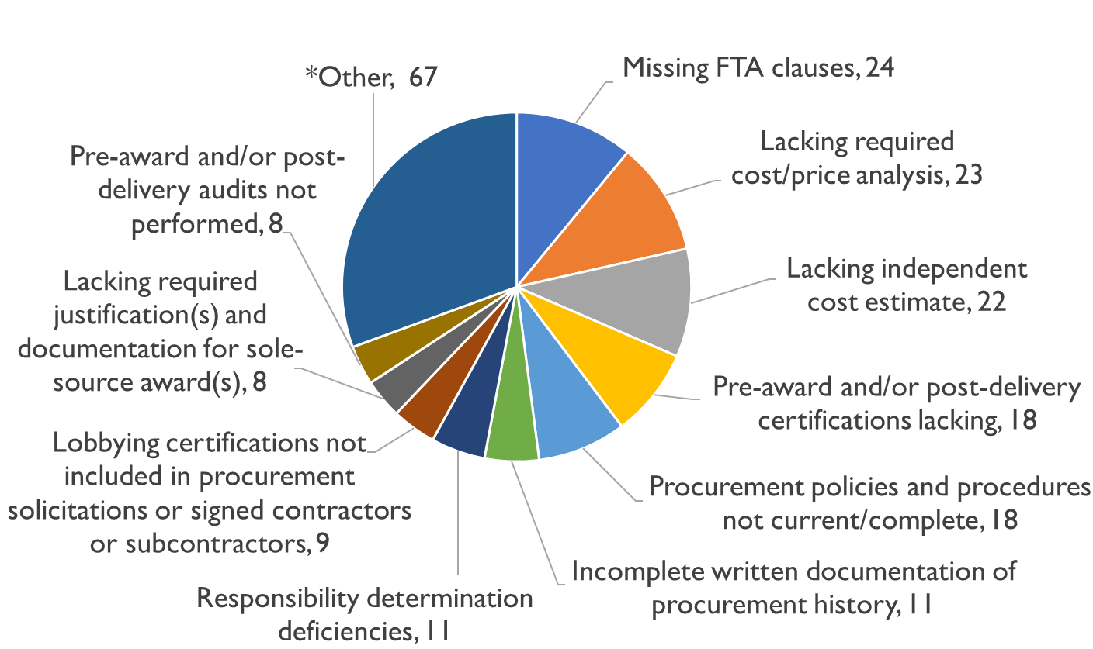
FY21 Procurement Findings
56 of 99

Slide 57
Federal Clauses
Number #1 Deficiency – Missing FTA Clauses
Issues
Procurement Lacks Any FTA Clauses
Procurement Lacks Specific FTA-Required Clauses
Failure to Recognize that Some Clauses Apply to All Procurements
Notes:
6

Slide 58
Federal Clauses
Resources
FTA Master Agreement
FTA Best Practices Procurement Manual (BPPM)
FTA Circular 4220.1F, Appendix D-4
2 CFR§200.324
Appendix II to 2 CFR Part 200
National RTAP’s Procurement Pro
Notes:
6

Slide 59
Federal Clauses
Applicability
Clauses Must be Used in Purchases Over the Micro-Purchase Level
Some Construction Clauses (Davis-Bacon) Required for Lesser Amounts ($2,000+)
Notes:
6

Slide 60
Federal Clauses
Best Practice Methods
Develop Independent Cost Estimate
Classify the Procurement in Accordance with FTA Defined Categories
Professional Services/A&E
Operations/Management
Rolling Stock
Construction
Materials & Supplies
Notes:
6

Slide 61
Federal Clauses
Best Practice Methods
Use ProcurementPro Tool
Avoid “Shotgun” Approach (e.g., Copying and Pasting All FTA Third Party Clauses, Even When They Do Not Apply)
Notes:
6

Slide 62
Federal Clauses
Best Practice Methods
Include All Applicable Clauses in the Solicitation Documents
Do Not
Incorporate by Reference
Simply Refer to the Master Agreement
Notes:
6

Slide 63
Cost/Price Analysis
No. #2 Issue – Lacking Required Cost/Price Analysis
Major Regulatory Change with 2 CFR§200.323(a)
Required for Procurements Over the Simplified Acquisition Threshold
FTA Circular 4220.1F States Such Analysis is Required for Every Procurement
Issue: Procurement File Lacks Documentation that the Required Analysis Was Performed
Notes:
6

Slide 64
Price Analysis
Price Analysis
Adequate Price Competition
Conditions
Two or More Offerors that Meet the Requirements of the Solicitation
Determination of Responsibility
Pricing is Responsive to Terms of the Solicitation
Notes:
6

Slide 65
Cost Analysis
Cost Analysis
Admittedly, More Complex and Time-Consuming that Price Analysis
Review and Evaluation of the Separate Cost Elements and Profit in an Offeror’s Proposal
Notes:
6

Slide 66
Cost Analysis
Issue: Transit Agency Fails to Conduct Cost Analysis in Other Situations Where it is Required
Contract Modifications
Competition is Inadequate (Sole Source, Single Bid)
Sole Source (Unless “Reasonableness” Can be Established)
Change Orders
Notes:
6

Slide 67
Independent Cost Estimate
No. #3 Issue – Lacking Independent Cost Estimate (ICE)
Issue
ICE Not Prepared
ICE Not Prepared Prior to the Receipt of Bids or Proposals
ICE Lacks Independence
ICE Predicated on Cost Quote from a Single Vendor
Notes:
6

Slide 68
Independent Cost Estimate
Best Practices
Adopt Procurement Policies that Incorporate the Development of the ICE as Integral Element of the Procurement Process
Conduct Requisite Market Research
Ensure the ICE is Documented
Notes:
6

Slide 69
Presenter
Greg Harnett, Senior Associate
RLS & Associates, Inc.
Corporate:
3131 S. Dixie Highway, Suite 545
Dayton, OH 45439
(936) 299-5007
gharnett@rlsandassoc.com
Notes:
6

